Slide 1

Network Design Proposal For NTU’s IoT Research Center
By: Koo Wai Kit (TP081761)
Notes:
Hi, welcome to my presentation. Today, I’ll be presenting my network redesign for NTU’s IoT Research Center.
NTU or National Technological University has been a leader in academic excellence and research in Malaysia since it was founded in 1992.
Recently, the IoT Research Center’s Local Area Network (LAN) was discovered to be underperforming, which caused major disruptions to the critical research happening there, especially in areas like cybersecurity. To tackle this, the ICT team, along with faculty and students, decided to rebuild the LAN, aiming for a high-speed, dedicated network that could better support their research.
In this presentation, I’ll walk you through the new network design and explain how it meets the center’s needs for reliability, speed, and scalability.

Slide 2
Table of contents
01
02
03
04
05
Background
Floor Plan
NetSim Network Design
Network Configuration and Justifications
Conclusion & QnA
Notes:
This will be the content of the presentation. First, I will provide a background on the project, followed by presenting a floor plan of the research center.
Next, I will describe the network design that was created in NetSim, then I will provide the configuration and explain why I choose these specific configurations.
Lastly, i will provide the conclusion of this project and presentation.

Slide 3

01
Background
Notes:
Lets start with the background.

Slide 4

Background
Objective: Design a robust and secure LAN for NTU's IoT Research Center.
Approach: Utilize NetSim for simulation and configuration.
Key Considerations:
Floor plan
Routing protocols
Wireless standards
Infrastructure connectivity
Data security
Network management
Notes:
The primary objective of this project is to establish a secure and dependable Local Area Network within the IoT Research Center. To achieve this, I will be using NetSim for comprehensive simulation and configuration, ensuring the creation of a high-speed network capable of meeting the demands of cutting-edge research.
In the design process, I carefully considered several key factors, including:
The optimal layout of the research center's floor plan for strategic placement of network devices.
The selection of efficient routing protocols to ensure fast and reliable data transfer.
The implementation of advanced wireless standards to accommodate a large number of devices simultaneously.
The wired and wireless connectivity to connect the network devices within the center.
Robust data security measures to safeguard sensitive research data from potential threats.
A comprehensive network management strategies for maintaining the network quality and reliability.
However, in this presentation I will only be discussing about the floor plan, routing protocols, wireless standards, and data security aspect of the network.

Slide 5

02
Floor Plan
Notes:
Moving on, lets have a look at the floor plan.

Slide 6
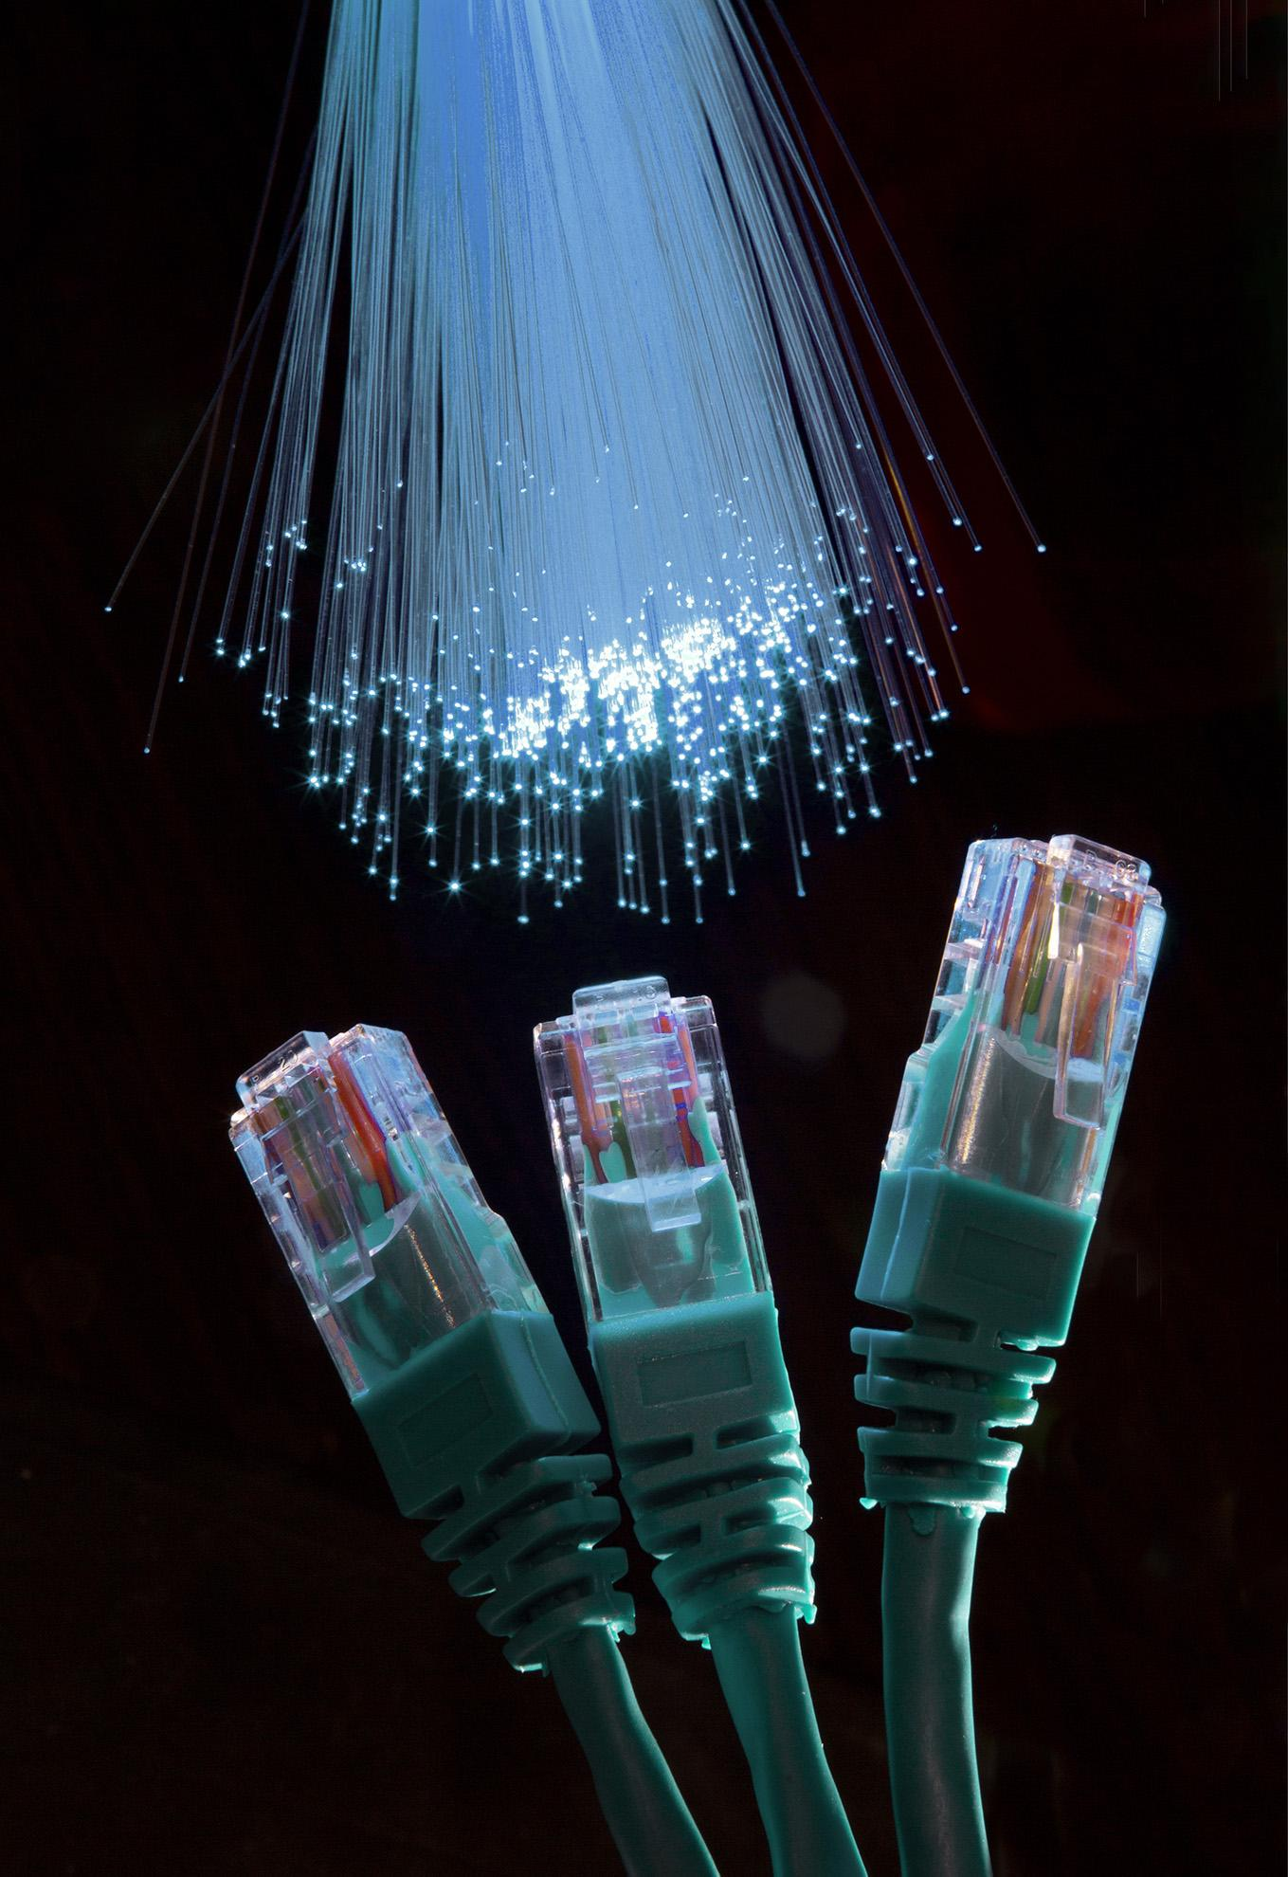
2 Floors
Key Areas
Identical layouts, 3000 sq. ft each
10 Workstations
2 Printers
General Testing Area
Specialized Lab
Meeting Room
Notes:
So the IoT Research center will consist of 2 floors with identical layout, and each floor spans 3000 square feet. Key areas on each floor include 10 wired workstations, a printer station with 2 printers, a general testing area, and a meeting room. These areas are crucial to determine the optimal placement of network components.

Slide 7
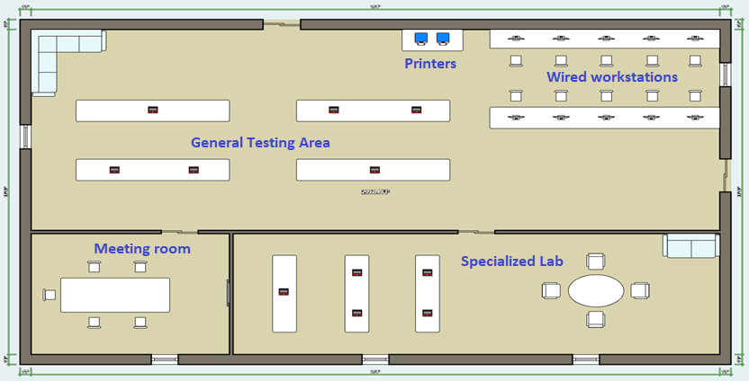
2D Layout
Notes:
This is how the floor plan looks like, first we have the wired workstations on the top right corner, with printers on the side.
The general testing area has 4 tables or workstations to test the IoT devices, the specialized lab has 3 workstations and a discussion area.
The last area is the meeting room with a discussion table and a television.

Slide 8
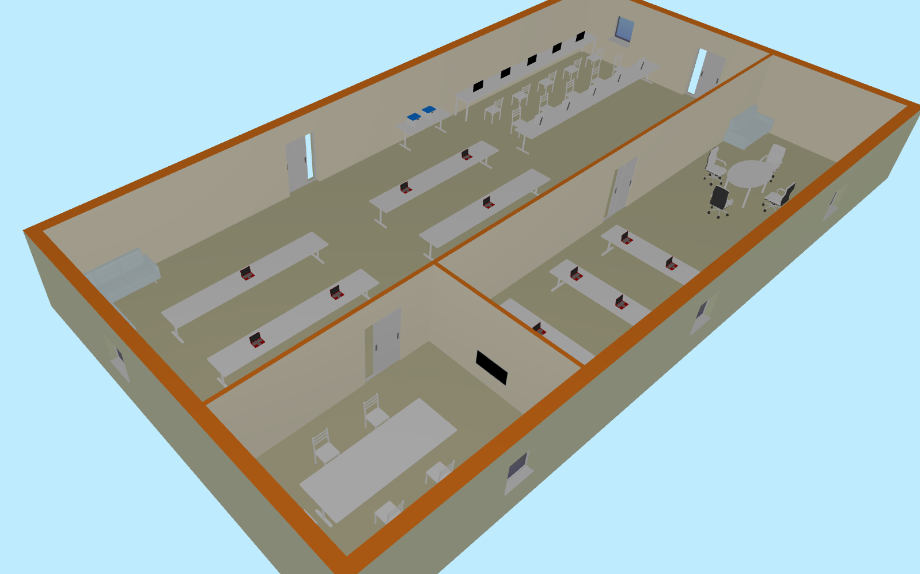
3D Layout
Notes:
This 3d layout offers a more realistic view of the research center, showing the different areas more clearly.

Slide 9

03
NetSim Network Design
Notes:
Next, I will be explaining how the network is designed in NetSim.

Slide 10
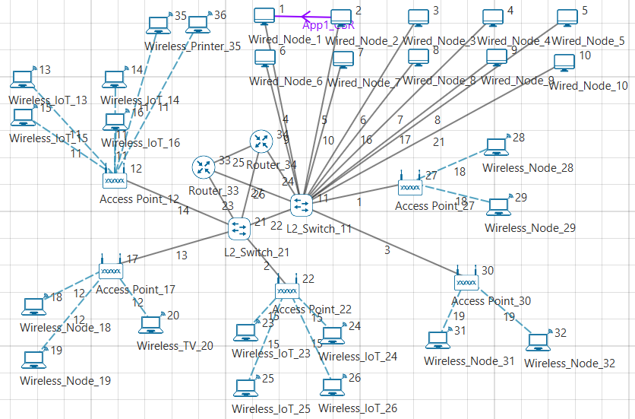
NetSim Network Design
Components
5 WAPs
Comprehensive wireless coverage
Support IoT devices & general use
Improve network reliability
2 Switches
Segment network
Reduce collisions & network congestion
Enhance performance & scalability
2 Routers
Internet connectivity
Router failover (backup)
Load balancing
Provide a reliable and effective high-speed LAN for the center
Notes:
Let’s take a closer look at how I’ve positioned the key components in the network to provide the best possible performance:
Wireless Access Points (WAPs):
I’ve placed five WAPs per floor to guarantee comprehensive wireless coverage. These access points are designed to handle both general devices and IoT equipment. With this setup, we not only improve connectivity for all devices but also enhance network reliability. If one access point fails, the others can take over seamlessly. Imagine dozens, maybe hundreds of sensors, cameras, and smart equipment all working at once. With this many devices connected, having multiple access points helps to balance the load, ensuring every device gets the bandwidth it needs.
Switches: Next are the switches. I’m deploying two high-capacity switches to manage and optimize the network's wired connections. These switches are crucial because they segment the network into smaller, more efficient sections. By doing so, we reduce traffic congestion and potential data collisions, which is essential for boosting overall performance. This segmentation also allows for future scalability, ensuring the network can grow with the research center.
Routers: To maintain reliable internet connectivity, I’ve included two routers. These routers provide failover capabilities—if one fails, the other immediately takes over, ensuring no interruption to the network. On top of that, the routers will be configured for load balancing. This means they’ll automatically distribute network traffic, preventing any bottlenecks and making sure everyone has fast, stable access to the internet.
Together, these elements provide a reliable and effective high-speed LAN for the research center.

Slide 11

04
Network Configuration and Justifications
Notes:
Now, let’s dive into the reasoning behind the specific configurations I’ve chosen:

Slide 12
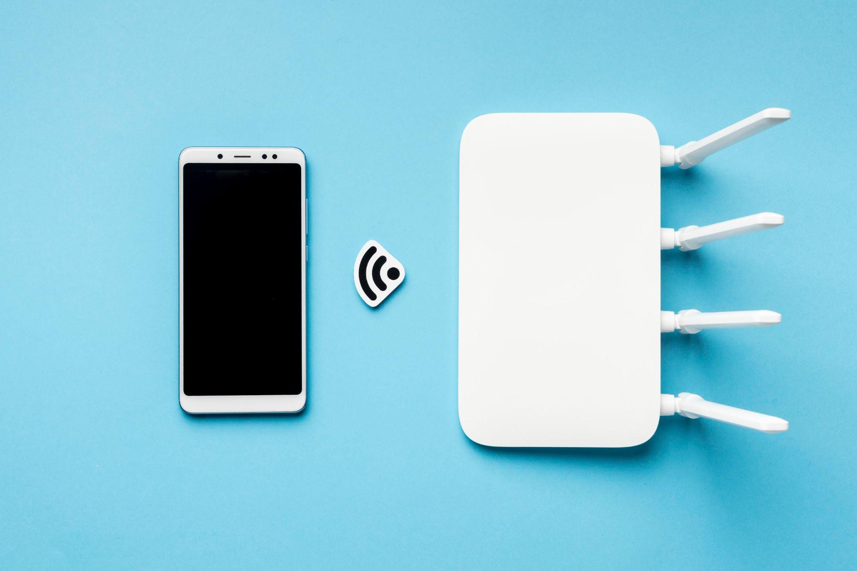
Network Configuration
Routing Protocol: Open Shortest Path First (OSPF)
Suitable for large, complex networks
Efficiently manages network changes and balances load
Faster convergence than RIP
No hop count limitations like RIP (better for growth)
aligns with the center’s potential for growth
Wireless Standard: IEEE 802.11ac
Superior performance (up to 6.93 Gbps throughput)
Wider bandwidth channels (efficient for high demand)
caters to high-demand research environment of the IoTRC
Encryption Algorithm: Advanced Encryption Standard (AES)
Strong security against unauthorized access.
Efficient and compatible with modern hardware acceleration.
well-suited for the center's data-intensive research applications
Notes:
Routing Protocol: Open Shortest Path First (OSPF): I’ve selected OSPF as the routing protocol because it’s ideal for large, complex networks like the one at the IoT Research Center. OSPF efficiently manages network changes and balances traffic loads dynamically. It also has faster convergence times compared to RIP, ensuring minimal downtime. Unlike RIP, OSPF doesn’t have hop count limitations, making it better suited for long-term growth as the center expands.
Wireless Standard: IEEE 802.11ac: To handle the center’s high bandwidth demands, I’ve chosen the IEEE 802.11ac wireless standard. It offers superior performance, with speeds of up to 6.93 Gbps, and uses wider bandwidth channels to manage high traffic efficiently. This is crucial in a research environment where multiple users and IoT devices are running data-intensive applications simultaneously.
Encryption Algorithm: Advanced Encryption Standard (AES): For security, I’m implementing AES encryption. AES is well-known for its strong protection against unauthorized access, making it perfect for safeguarding sensitive research data. It’s also efficient and compatible with modern hardware, so it won’t slow down the network, even during data-heavy operations.
These choices ensure the network is both secure and capable of supporting the IoT Research Center’s data-intensive work.

Slide 13

05
Conclusion & QnA
Notes:
Finally, I will be concluding the presentation.

Slide 14


Conclusion
Good Foundation
Optimized for Research
The network design provides a secure, scalable, and high-performance foundation for NTU's IoTRC
empowers researchers to focus on innovation without limitations from their network infrastructure
Routing protocol, wireless standard, and encryption algorithm are strategically selected to support the research needs
prioritizes network performance and data security
Notes:
In conclusion, this network design forms a solid foundation for NTU's IoT Research Center—one that prioritizes security, scalability, and high performance.
By selecting the most suitable routing protocol, wireless standard, and encryption algorithm, this network is well-equipped to support the center's diverse and demanding research activities.
It allows researchers to focus on innovation, without limitations from the network infrastructure.

Slide 15

Thanks!
Do you have any questions?
Notes:
That’s all for my presentation. If you have any questions, pls message me on Teams and I will get back to you as soon as possible. Thank you for watching, have a good day.

